Slide 1
Assignment-1 Discussion (Word Vectors and Analogy Test)
Mahesh Ashok Abnave, 203059010
Akshay Eknath Mali, 213079006
Joshi Meet Anilkumar, 21319R001
Sanjna Mohan, 20305R006
13 Feb 2022

Slide 2
Problem Statement (1/2)
In this assignment, you will have to implement the backpropagation algorithm from scratch. After implementing backpropagation ab-initio, train CBow and Skip-gram with backpropagation. (This link might help as a quick refresher for Skip-gram and CBoW.)
The task is to compare the performance of CBoW and Skip-gram embeddings on the word analogy task.
Analogy task: Given an analogy, find a word by correctly determining its relationship with another word. For example,

Slide 3
Problem Statement (2/2)
man:woman :: king:_____
( man is to woman, what king is to ____ )
The blank should be filled with “queen”.
Input: An analogy pair with one blank. For e.g.,
Delhi:India :: Paris:_____
Output: The correct word to satisfy the analogy given in the input.
You will have to report on the validation data:
Accuracy
Compare the performance of CBoW and Skip-gram models.
Perform detailed error analysis

Slide 4
Working with Data
Data Scraping to facilitate analogy:
Analogies Google API Relevant URLs
Google search: “India rupees en.wikipedia.com”

Slide 5
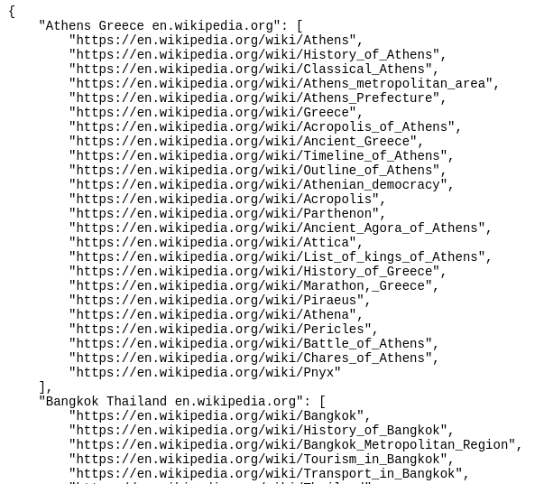
Working with Data
Data Scraping to facilitate analogy:
urls.json

Slide 6
Working with Data
Data Scraping to facilitate analogy:
Analogies Google API Relevant URLs
Google search: “India rupees en.wikipedia.com”
urls.json WikipediaAPI Sentences JSON
{
"Athens Greece": {
"word1": [ ... word1-only sentence list ... ]
"word2": [ ... word2-only sentence list ... ]
"bothwords": [ ... both words sentence list ... ]
},
... rest of the analogy pairs ...
}

Slide 7
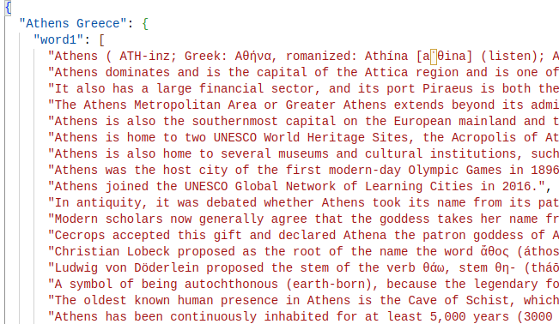
Working with Data
Data Scraping to facilitate analogy:
sents.json

Slide 8
Working with Data
Data Scraping to facilitate analogy:
Analogies Google API Relevant URLs
Google search: “India rupees en.wikipedia.com”
urls.json WikipediaAPI Sentences JSON
Stats
Avg word 1 sents: 601
Avg word 2 sents: 652
Avg both word sents: 128
Priority: “both words” sentences

Slide 9
Working with Data
Pre-processing:
Stop words removal
Punctuation removal
Only alphabetical word (no numbers and other language characters)
Lower casing non Proper noun words
No lemmatization (may lose morpological / syntactical information, e.g. “run : runner” will become “run : run”)

Slide 10
Experimental Setup
Embedding size | Window size | No of sentences / word | Total Skipgrams
170 | 3 | 200 | 659420
300 | 3 | 200 | 659420
400 | 3 | 200 | 659420
500 | 3 | 200 | 659420
170 | 3 | 200 | 659420
No. epochs: 35
Learning rate: 0.25 to 0.008
Vocabulary size: 49245
Embedding dim: 130-500

Slide 11
Results
Embedding size | Window size | No of sentences / word | Total Skipgrams | Skipgram | CBOW
170 | 3 | 200 | 659420 | 0.409 | 0.27
300 | 3 | 200 | 659420 | 0.26835 | 0.26
400 | 5 | 60 | 659420 | 0.0021 | 0.0001
500 | 5 | 60 | 659420 | 0.0013 | 0.0000
Last two cols: validation accuracy

Slide 12
Results (embedding size = 130)
Embedding size | Window size | No of sentences / word | Total Skipgrams | TopK | Skipgram | CBOW
130 | 3 | 200 | 659420 | 1 | 0.03835 | 0.02421
130 | 3 | 200 | 659420 | 10 | 0.10797 | 0.06962
130 | 3 | 200 | 659420 | 50 | 0.19778 | 0.13824
130 | 3 | 200 | 659420 | 100 | 0.24318 | 0.16851
130 | 3 | 200 | 659420 | 500 | 0.33198 | 0.24924
No. epochs: 35
Learning rate: 0.25 to 0.008
Vocabulary size: 49245
Embedding dim: 130-500

Slide 13
Results
Accuracy figure
<There is only one kind of test: A:B :: C:___> fill in the 4th entity

Slide 14
Observations and Analysis
Numpy 80 hours Cupy 13 hours
Better CBOW training loss than Skipgram. Because its faster to train In line with empirical observation. ref
Better Skipgram analogy accuracy than CBOW Because its of no averaging. In line with empirical observation. ref
Smaller embedding size performs better than larger May be because larger embedding overfits OR need more time / data to train
Constant high LR gives NaN
Able to fit bigger minibatch with:
short16 for one hot vectors and
float32 for weights

Slide 15
Backpropagation
Implementation 1 (softmax)
Layers
Input layer: |V|x|e| = 4309 x 100
Output layer: |e|x|V| = 100 x 4309
Context size: 3
Implementation 1 (negative sampling)
Layers
Input layer: |V|x|e| = 6309 x 100
Output layer: |e|x|V| = 100 x 6309
Context size: 3

Slide 16
Demo
<on notebook, show>
<remain ready; no hurry scurry during the evaluation>
<should take evaluators examples>

Slide 17
Marking (max 100)
Data pre-processing: 10 (no pre-processing 0)
Scraping: 20 (respectable size and good scraping strategy full marks)
Good implementation of BP: 20
Accuracy: >90: 20 marks; >70-90: 10 marks; >50-70: 5 marks; else 0
Analysis: 10 marks
Comparison of CBOW and Skip Gram: 10 marks
Demo: 10 marks
Topper of leader board: 5 marks bonus

